Slide 1
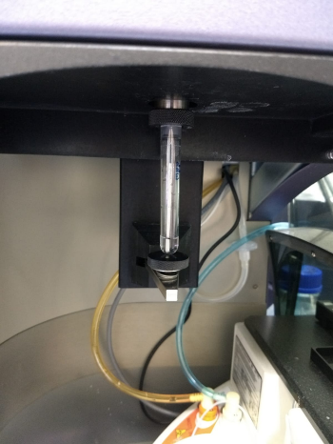
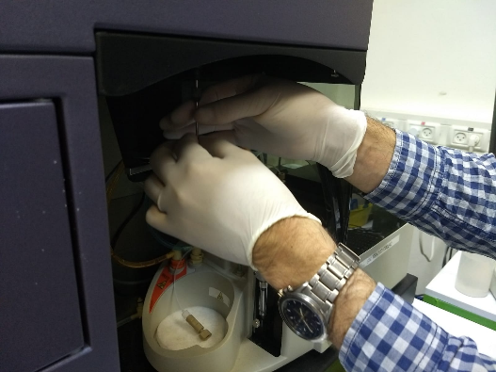
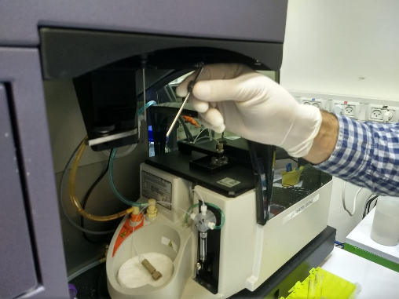
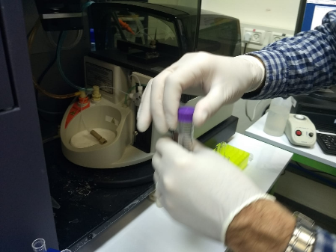
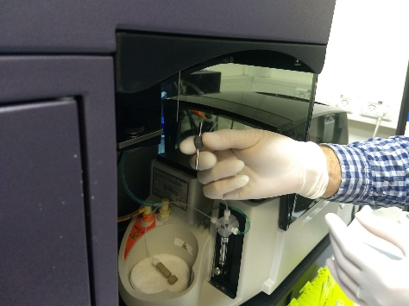
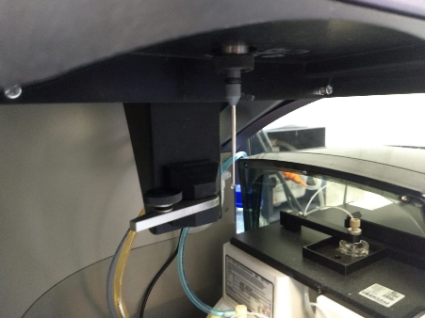
HTS on Fortessa
Prepare control samples in regular FACS tubes. Run and fix setting before HTS.
1. Remove the FACS tube from the sample needle
2. Remove the LONG sample needle
3. Install the SHORT sample needle

Slide 2
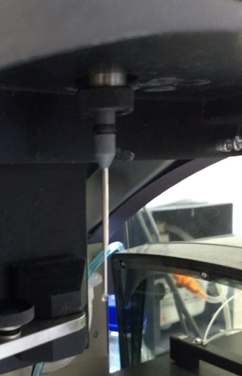
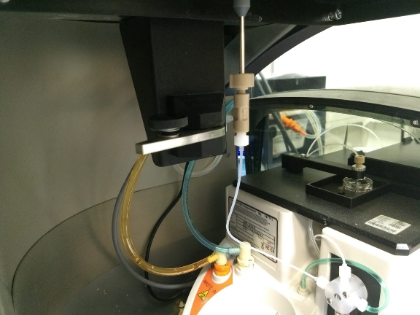
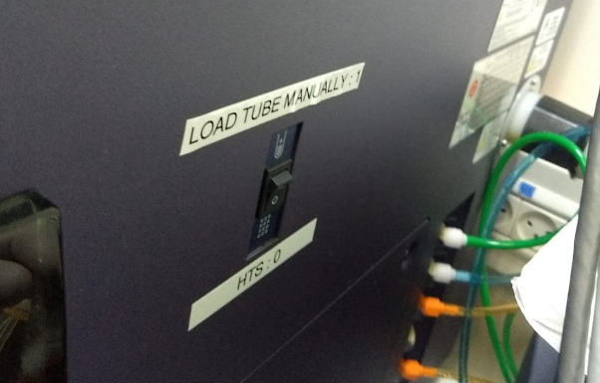
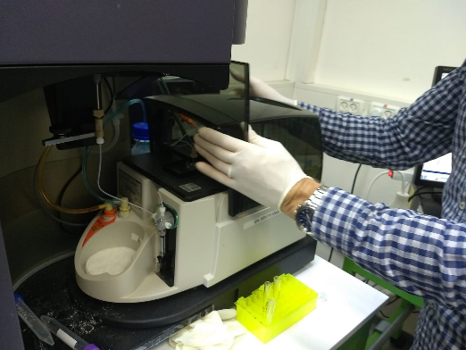
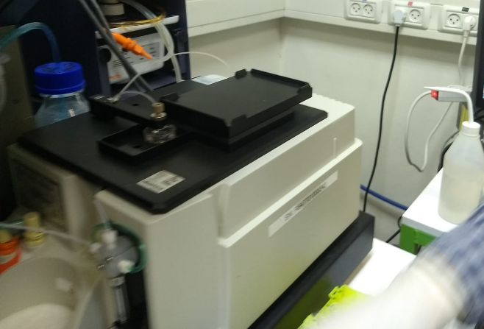
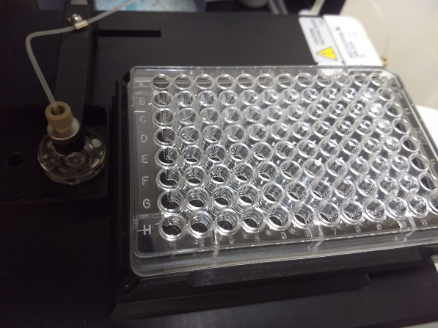
4. Connect the HTS tube to the narrow gauge needle
5. Switch the button (on the side of the machine) to HTS mode. In front of the machine: Put on Run and low
6. Remove the Fortezza plate cover:
Put in the 96 well plate A1 well at the far left side
Close the cover – make sure the cover magnet touches the white autosampler body.

Slide 3
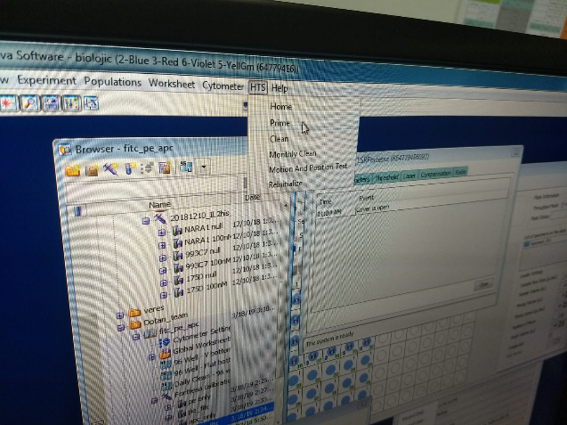
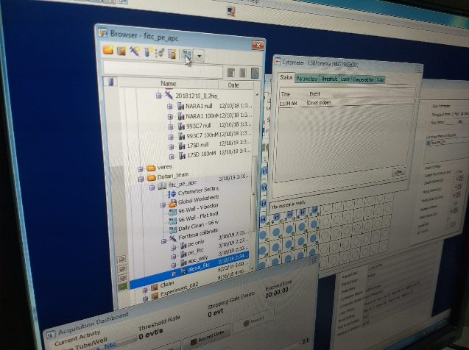
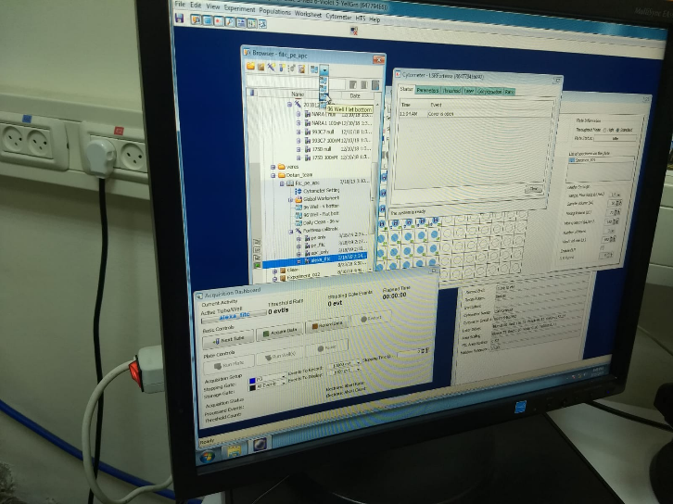
7. On the Fortezza control panel:
Press HST scroll down menu
Press prime
The Fortezza auto sampler will do a priming procedure, this will take about 2-3 minutes.
Repeat prime x3 a total of three washes
8. On the Fortezza Browser:
Press the 96 well plate icon
Select the right kind of 96 well plate

Slide 4
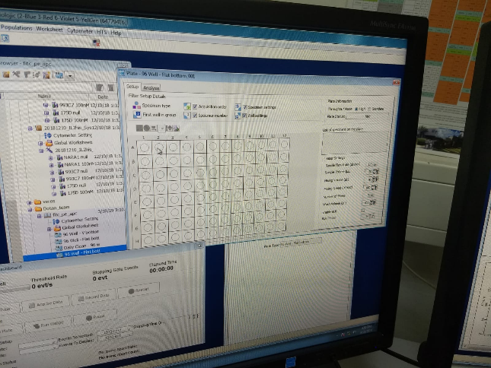
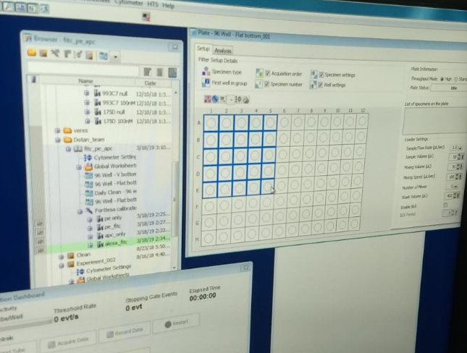
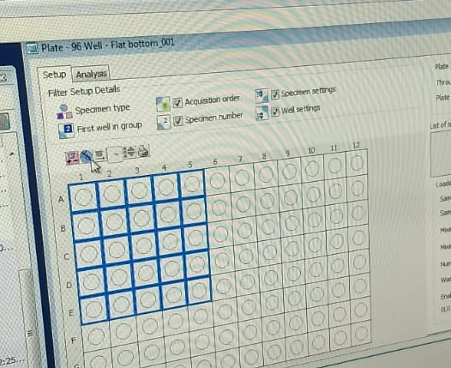
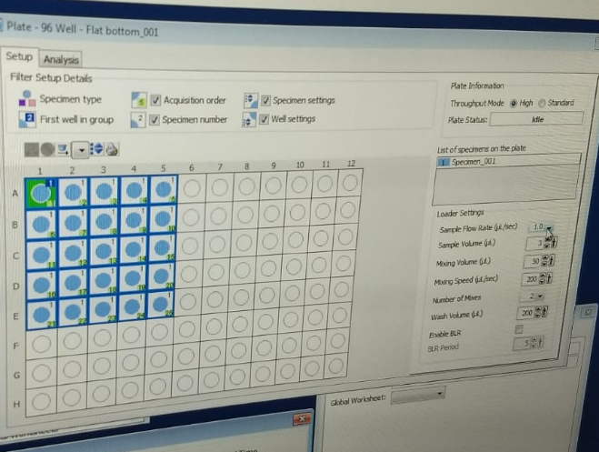
9. On the Fortezza plate control:
Select the number of wells to be tested
Press the syringe icon
The well should turn blue

Slide 5
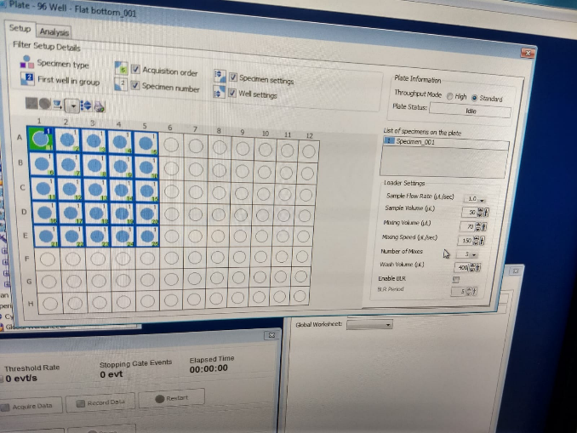
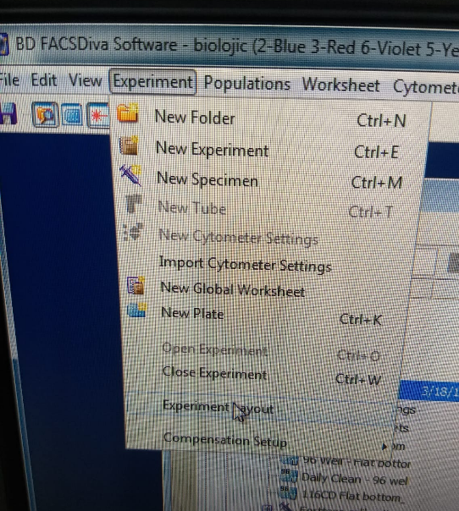
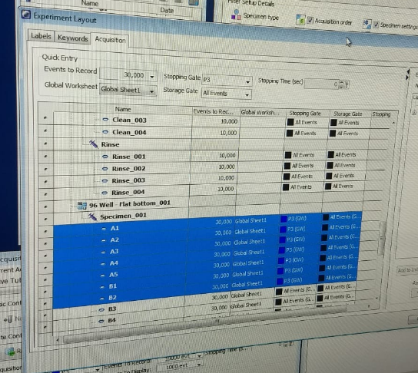
10. On the Fortessa plate control:
Make sure all the well are selected
Adjust the sample flow rate, size mixing parameters etc.
Plate information: standard
Start initial experiment with 1ul/sec flow
Sample size 30ul smaller then what's in the well (this is the dead volume)
Mixing 3 times with ½ of sample volume
Mixing speed 150ul/sec
Wash volume- between samples 400ul
Enable BLR (BLR period 50)
11. On the Fortessa control:
Select experiment dropdown menu
Select experimental layout.
Highlight All the relevant wells and choose how many events to count and from which gate
Select global worksheet

Slide 6
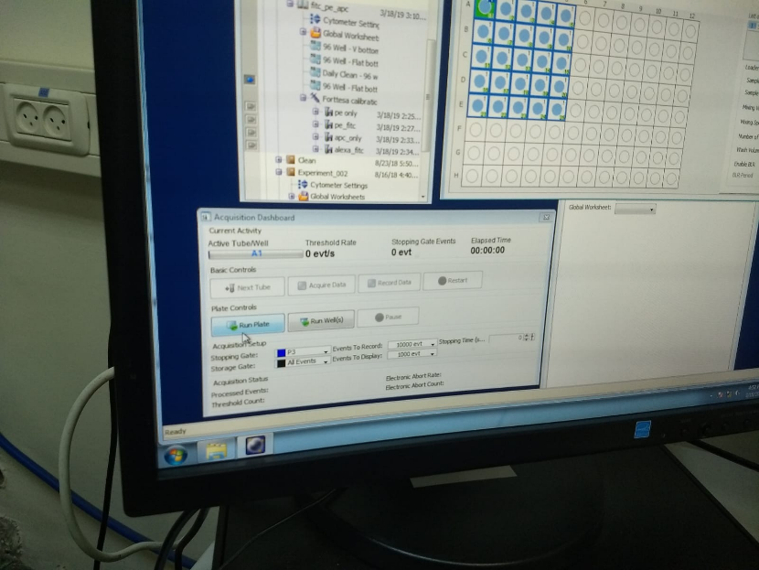
12. On the Fortessa acquisition control:
Acquire for running without recording. Can change voltage while running
Or
Press Run Plate or Run wells for specific wells to record. All of the wells that were set for the experiment should be processed
13. Cleaning
Prepare plate with 250ul in each well:
clean in F8→F12
Rinse in G8 →G12
DDW in H8→H12
New experiment →HTS clean. It will take ~20min
When it finished, take out the short needle and put back the long one.
button on the side of fortessa → manual
Good Luck ☺

